Slide 1

101
Alejandro & Jing

Slide 2
Step 1: Install Julia
Current stable release: v1.9.1 (June 7, 2023)
Choose the correct version for your operating system
https://julialang.org/downloads/#current_stable_release

Slide 3
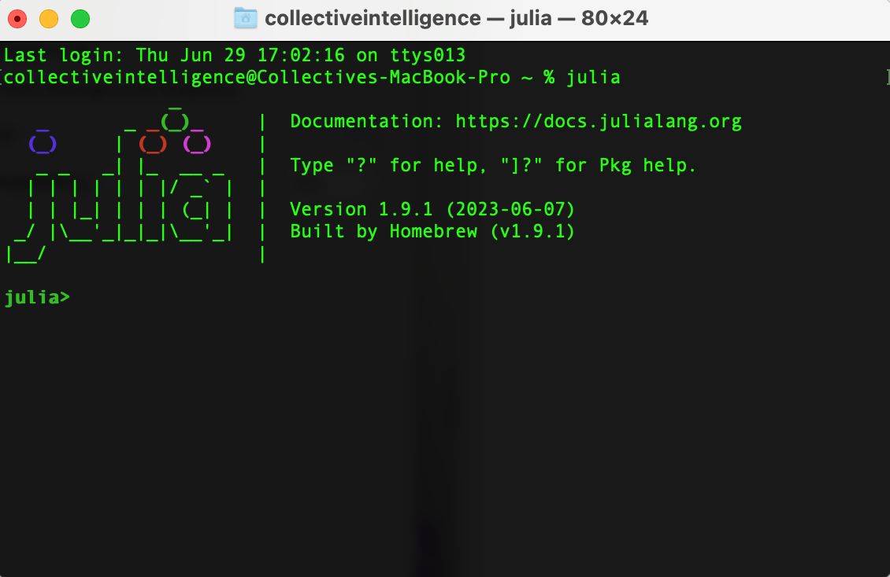
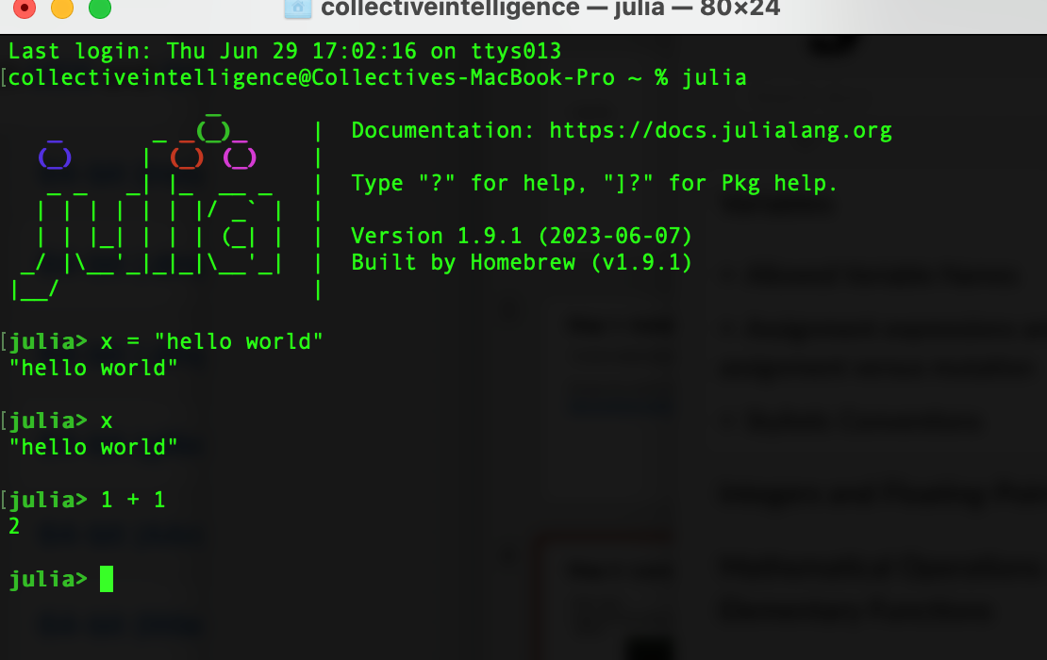
Step 2: Launching Julia REPL (command-line interface)
For Mac Users:
Open terminal, type julia in the command line. If you see pic.1 you are all set.
Check whether julia is working properly by typng: x = “hello world” or 1 + 1. (pic.2)
pic.1
pic.2

Slide 4
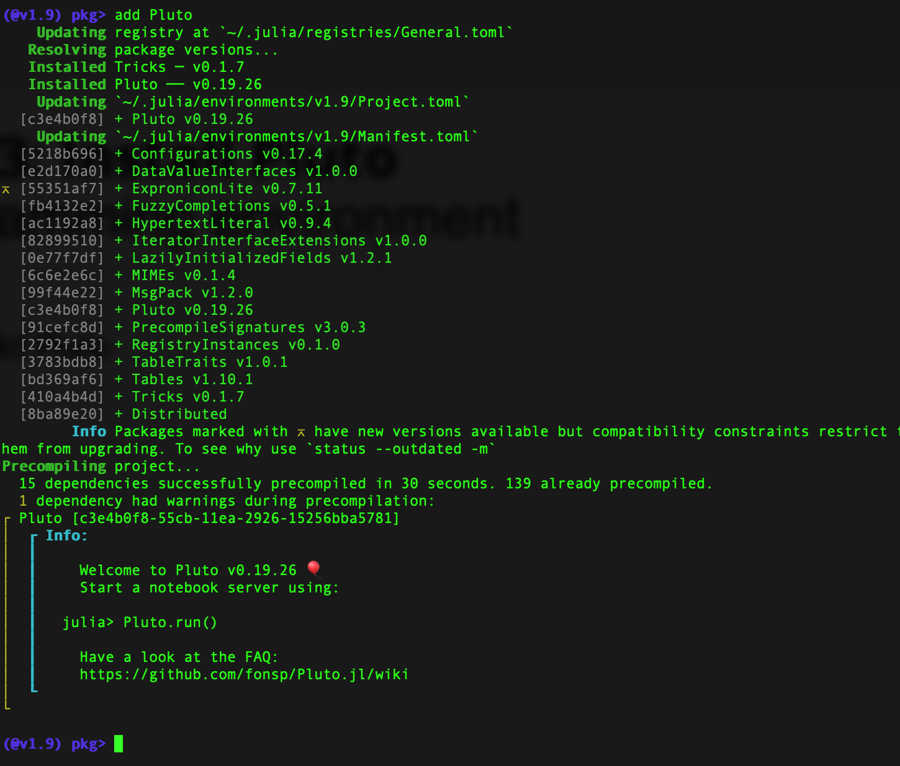
Step 3: Install Pluto Programming environment
Type: ]
Then: add Pluto

Slide 5
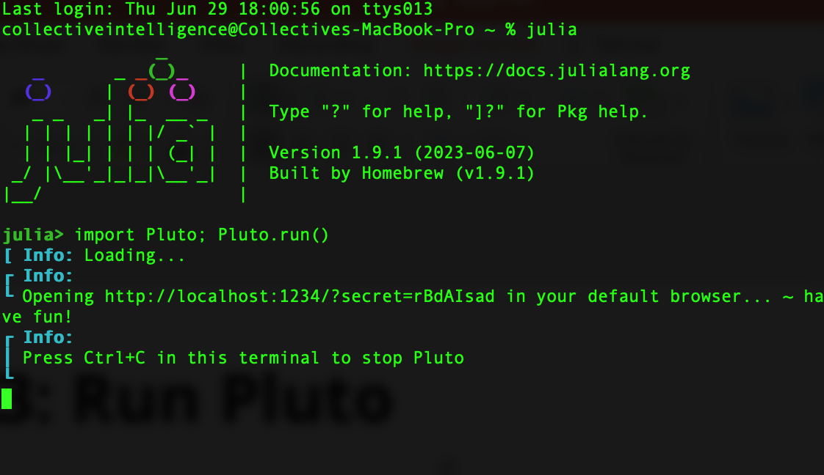
Step 3: Run Pluto
Type: import Pluto; Pluto.run()
Pluto runs automatically or copy and paste the URL in the info to your browser. (Not the one in this pic)
All set!

Slide 6
What’s next
Julia with Editors and IDEs
https://julialang.org/
VS code: https://code.visualstudio.com/docs/languages/julia
Julia 1.9 Documentation
https://docs.julialang.org/en/v1/
More tutorials:
https://julialang.org/learning/
Computational modeling with Julia
https://computationalthinking.mit.edu/Fall22/

